Slide 1
Journey to Wellness Rx
Natouchka Murray
Health Services Representative

Slide 2
What is the Journey to Wellness Rx ?
A non-pharmaceutical prescription
Provided by healthcare personnel (nurses, HSR, health educators, etc.)
Recommends physical activity, healthy eating & tobacco cessation
Aims to help with weight or chronic disease management
Will facilitate access to all Miami-Dade’s community resources that promote and assist individuals with creating a healthy lifestyle
Notes:
* Healthcare professionals- not only doctors, or nurses, but anyone providing a direct health care service.

Slide 3
Background
Originated in New Zealand in 1998
Originally known as the Green Prescription (GRx)
2 Components
GRx: For Adults
GRx Active Families: Aims to increase physical activity for children, young individuals and their families
GRx has been used by over 80% of New Zealand general practitioners

Slide 4
Impact
GRx Patient Survey 2018
Sample: Almost 3000
Reason for being issued a GRx: 52% ‘weight problems’, 23% high blood pressure & risk of stroke
6-8 months after GRx:
71% have noticed positive changes in their health
65% have made changes to their diet
67% have encouraged others to be active
61% still more active than they were before getting GRx
43% have lost weight
https://www.health.govt.nz/publication/green-prescription-patient-survey-2018-report

Slide 5
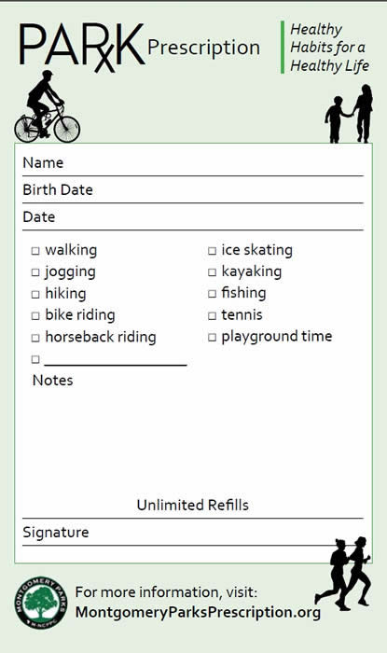
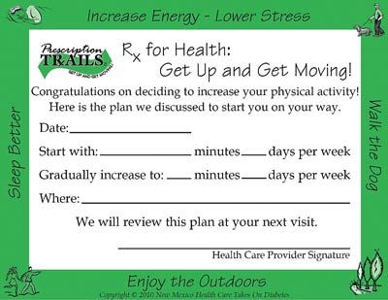
Green Prescription- Samples
New Mexico
Notes:
Montgomery, New Mexico

Slide 6
Green Prescription- Samples
U.S. National Environmental Education Foundation

Slide 7
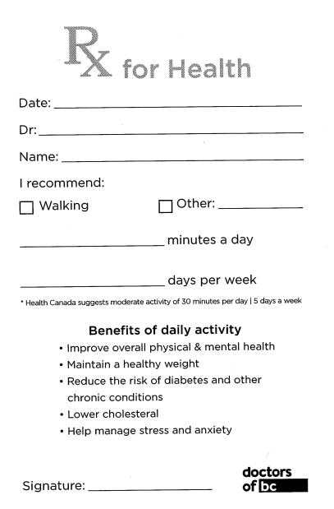
Green Prescription- Samples
Canada

Slide 8
Journey to Wellness Rx (DOH-Miami-Dade’s version of the Green Prescription)
In Use by OCH&P Community Health Action Team (CHAT) since Dec. 2015
Health Fairs, Health Promotions, Health & Wellness Center in Liberty City at Frederica Wilson & Juanita Mann HC
69,818 distributed (Dec 2015-September 2020)
Follow-up clients report healthy lifestyle modifications

Slide 9
Journey to Wellness Rx – Next Steps
DOH-MD employee Worksite Wellness program
Other DOH-Miami-Dade direct service programs to distribute to their clients (on-site clinical areas and at outreach activities)
Dental
HIV/STD
Refugee Health
School Health
Tuberculosis Control & Prevention
WIC
Women’s Health & Preventative Services
Other optional partners: Miami-Dade County Parks Recreation and Open Spaces, The Children’s Trust, Healthy Start Coalition providers, West Kendall Baptist Hospital, University of Miami, and Barry University

Slide 10
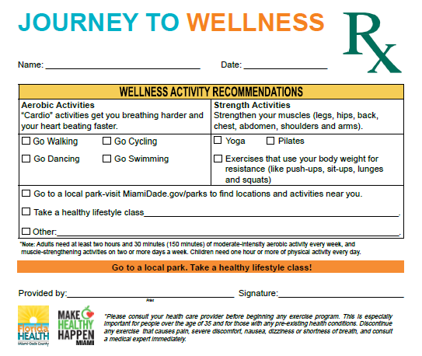
Journey to Wellness Rx – Front

Slide 11
Journey to Wellness Rx – Back
Notes:
Life’s Simple 7 Questions

Slide 12
Sources
http://www.health.govt.nz/our-work/preventative-health-wellness/physical-activity/green-prescriptions
https://www.health.govt.nz/publication/green-prescription-patient-survey-2018-report
https://www.neefusa.org/resource/rx-outdoor-activity
Sue Garrett et al. The British Medical Journal, Volume 61, Number 584, March 2011.
Notes:
Originating website
Google search: green prescription new Zealand

Slide 13
Thank You!
Any questions?
Natouchka Murray, CCHW- Health Services Representative
Florida Department of Health in Miami-Dade County
Office of Community Health and Planning
Email: Natouchka.Murray@FLHealth.gov
Phone: 305-234-5400, x 8848

