Slide 1
Florida Department of Health in Miami-Dade County
Maternal and Child Health Outcomes:
The Environmental Public Health Project
For Health Professionals
Office of Community Health and Planning
Notes:
Welcome to the presentation on The Environment and Infant and Maternal Mortality for Health Professionals.

Slide 2

What Is Included:
Define Infant Mortality & Maternal Mortality
Identify their importance
Understand the environment’s role in health
Identify “Hot Spots” where environmental concerns overlap with IM & MM statistics
Notes:
For this presentation we will define infant and maternal mortality, we will then go into their importance and why we should focus on them in our region along with he concerns we have as public health professionals. Next, we will highlight the environment’s role in health and the outcomes that come from it. Lastly, we will identify hot spots where environmental concerns overlap with the infant and maternal mortality rates in Miami-Dade County.
At the end of it all, we will review current and future initiatives to address the environmental concerns and mortality stats.

Slide 3
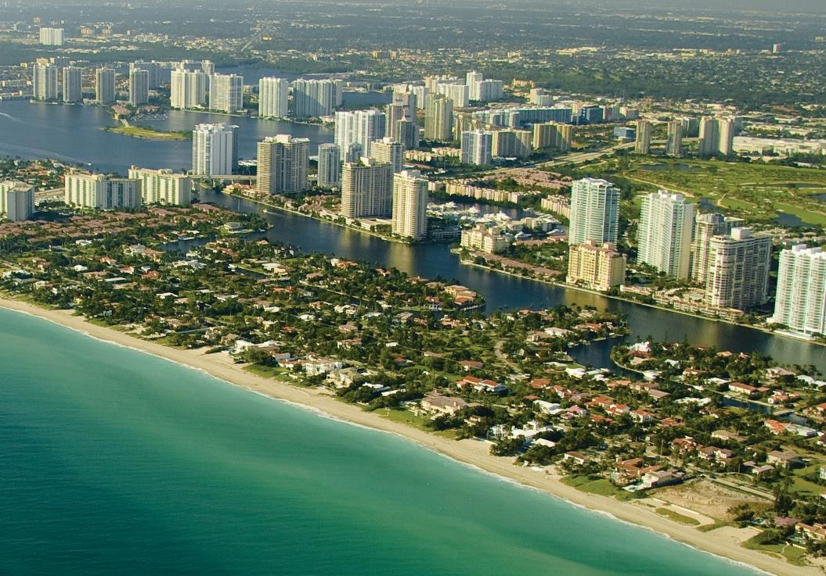
Miami-Dade County
2018 Population:
.
1
2,738,060
Notes:
First, let’s look at Miami-Dade county as a whole. Located in south Florida, Miami-Dade county has a population just over 2.7 million people. The region consists of 34 municipalities including Miami, Homestead, and Florida City.

Slide 4
Demographics
Miami-Dade County
Race Data Miami-Dade County
1
Notes:
In terms of Demographics, Miami-Dade is about 78.8% White, 17.9 % Black or African American, with smaller populations of Asian, American Indian/Alaska Native, Hawaiian, and two or more races.

Slide 5
Demographics
Miami-Dade County
1
Hispanic Origin Data Miami-Dade County
Notes:
In terms of ethnicity, 69.1% of the county identifies as being of Hispanic or Latin origin, leaving just over 30% of the population identifying as not Hispanic or latinx.

Slide 6

Infant and Maternal Mortality
In Miami-Dade County
Notes:
Now that we’ve looked at demographics, let’s look at infant and maternal mortality.

Slide 7
What Is Infant Mortality?
2
    Infant mortality is the death of an infant before their first birthday
    Infant Mortality Rate (IMR) is a measure of infant death expressed as the number of deaths per 1,000 live births in a specified period of time. The infant mortality formula is:
    Number of infant deaths x 1,000
    ---------------------------------------------
    Number of live births
Notes:
What is infant mortality? It is the death of an infant before their first birthday. This is expressed by the number of infant deaths per 1,000 live births in a specific time period – the calculation is here at the bottom of this slide.

Slide 8
Why is this important?
3
Infant Mortality Rates per 1,000 Live Births, Miami-Dade & Florida:
    The infant mortality rate is an important marker of the overall health of a society.
 | Miami-Dade | Florida
2015 | 4.8 | 6.2
2016 | 5.2 | 6.1
2017 | 5.1 | 6.1
2018 | 4.6 | 6.0
Socioeconomic
Availability, access, and quality of care
Health equity
Notes:
So why is this important? Infant mortality is an important marker of the overall health of a society, region, and/or community. It provides scientists and other public health professionals with a snapshot of health. We can look at socioeconomic factors, such as poverty and the education level, we can see if the region has high quality care that is affordable and accessible, and we can determine how equitable health is in the area.
To the right of the slide we have the infant mortality data for the years 2015 to 2018 and we are comparing Miami-Dade to Florida. Overall, we see that Miami-Dade has a lower Infant mortality rate compared to Florida and that the general rates have declined since 2016.

Slide 9
Disparities in infant mortality
3
Infant Mortality Rates per 1,000 Live Births, by Race Miami-Dade & Florida
 | Miami-Dade |  | Florida
 | White | Black | White | Black
2018 | 3.1 | 10.8 | 4.3 | 11.3
2017 | 3.5 | 11.5 | 4.4 | 10.8
2016 | 3.1 | 13.0 | 4.3 | 11.6
2015 | 3.4 | 8.8 | 4.4 | 11.4
Notes:
Moving forward, when we break down infant mortality by race we find one of the biggest disparities to date. Black populations within Miami-Dade and Florida are two to three times more likely to experience infant mortality compared to White populations. As you can see, this pattern hasn’t changed in previous years. In Miami-Dade, Black infant mortality spiked in 2016, but has been decreasing since. However, it’s still significantly higher than their White counterparts.

Slide 10
Disparities in infant mortality
3
Infant Mortality Rates per 1,000 Live Births, by Hispanic Origin Miami-Dade & Florida
 | Miami-Dade |  | Florida
 | Hispanic | Non-Hispanic | Hispanic | Non-Hispanic
2018 | 3.9 | 6.8 | 5.2 | 6.3
2017 | 4.3 | 6.2 | 5.2 | 6.2
2016 | 3.6 | 8.2 | 5.4 | 6.3
2015 | 3.7 | 6.2 | 4.8 | 6.5
Notes:
Similarly, Non-Hispanic populations in Miami-Dade and Florida have higher infant mortality rates compared to Hispanic populations.

Slide 11
Causes Of Infant Mortality
2
1
Birth Defects
2
Preterm Birth & Low Birth Weight
3
Maternal Pregnancy Complications
4
Sudden Infant Death Syndrome
5
Injuries
Notes:
So what causes infant mortality in the first place? What factors should we be concerned about? According to the Centers for Disease Control and Prevention, the top 5 causes of infant death in 2017 were: Birth defects, preterm birth and low birth weight, maternal pregnancy complications, sudden infant death syndrome, and injuries.
As you can see, we’ve highlighted preterm birth & low birth weight, maternal pregnancy complications, and sudden infant death syndrome. They will be highlighted throughout the presentation as the environment can play a major role in these outcomes.

Slide 12
Total | 2013 – 15 | 2016-18
All Causes | 4.6 | 5.0
Congenital Anomaly/Birth Defect | 96.3 per 100,000 | 106.8
Pre-term birth (<37 Weeks) | 9.7 % | 9.7 %
Sudden Unexpected Infant Death (SUID), per 1,000 live births | 0.5 | 0.5
Low birth weight (<2500 g) | 8.6% | 8.4%
Non-Hispanic Black Race | 2013- 2015 | 2016-18
All Causes | 8.8. | 11.8
Congenital Anomaly/Birth Defect | 180.8 | 245.0
Prematurity/Low Birth Weight | 13.3% | 13.7%
Sudden Unexpected Infant Death (SUID) per 1,000 live births | 1.4 | 1.3
Low birth weight (<2500 g) | 13.1% | 13.7%
Non-Hispanic White Race | 2013- 2015 | 2016-18
All Causes | 3.2 | 3.2
Congenital Anomaly/Birth Defect | 68.5 | 74.4
Prematurity/Low Birth Weight | 8.6% | 8.7%
Sudden Unexpected Infant Death (SUID) per 1,000 live births | 0.2 | 0.2
Low birth weight (<2500 g) | 7.2 % | 7.0%
Hispanic Ethnicity (All Races) | 2013- 2015 | 2016-18
All Causes | 3.4 | 3.9
Congenital Anomaly/Birth Defect | 70.9 | 85.0
Prematurity/Low Birth Weight | 8.8% | 9.1%
Sudden Unexpected Infant Death (SUID) per 1,000 live births | 0.3 | 0.3
Low birth weight (<2500 g) | 7.3% | 7.1%
SELECT CAUSES OF INFANT DEATH IN MIAMI-DADE COUNTY, 2013 - 2018
All data is from FlHealthCharts.Com
Notes:
As you can see, this slide has a lot of data. On this slide you’ll find select causes of infant death in Miami-Dade county broken down by race and ethnicity. Similar to previous slides, we find the black and non-Hispanic populations have higher rates of these causes.

Slide 13
What is Maternal Mortality?
4
The death of a woman during pregnancy, at delivery, or soon after delivery.
Maternal Mortality is a measure of Maternal death expressed as the number of deaths divided by total recorded (or estimated) live births in the same period and multiplying by 100,000.
Number of Maternal Deaths
--------------------------------------------- x100,000
Live births
Notes:
What is maternal mortality? It is the death of a woman during pregnancy, at delivery, or soon thereafter. It is expressed as the number of deaths divided by the total live births in the same period multiplied by 100,000 as seen on the slide.

Slide 14
Why Is This Important?
5
Maternal Mortality Rates per 100,000 Live Births, Miami-Dade & Florida:
 | Miami-Dade | Florida
2015 | 21.6 | 21.4
2016 | 15.3 | 16.9
2017 | 6.3 | 16.5
2018 | 12.9 | 18.1
Maternal Mortality be an indicator for population health and overall
quality of life.
Notes:
Why is this important? Like infant mortality, it is an indicator for population health. However, it also is a great indicator for overall quality of life. For this we look at the built environment, access and quality of care, as well as socioeconomic factors.
On this slide, we see that Miami-Dade and Florida have similar rates. Miami-Dade, however, saw an increase in maternal deaths from 2017 to 2018.

Slide 15
Disparities In Maternal Mortality
5
Maternal Mortality Rates per 100,000 Live Births by Race, Miami-Dade & Florida:
 | Miami-Dade |  | Florida
 | White | Black | White | Black
2018 | 8.3 | 34.3 | 16.5 | 24.7
2017 | 0.0 | 31.6 | 13.3 | 30.1
2016 | 8.0 | 45.4 | 14.3 | 24.3
2015 | 16.2 | 29.3 | 18.0 | 30.5
Notes:
These rates, similar to those of infant mortality, differ greatly when broken down by race. Here you’ll find that Black populations are three to four times more likely to experience maternal deaths compared to White populations. As of 2018, the Miami-Dade County Black population had a maternal mortality rate of 34.3 deaths per 100,000 live births, while the White population had a rate of 8.3 deaths per 100,000 live births.

Slide 16
Disparities In Maternal Mortality
5
Maternal Mortality Rates per 100,000 Live Births by Hispanic Origin, Miami-Dade & Florida:
 | Miami-Dade |  | Florida
 | Hispanic | Non-Hispanic | Hispanic | Non-Hispanic
2018 | 10.7 | 19.4 | 16.6 | 19.0
2017 | 0.0 | 18.1 | 10.5 | 19.3
2016 | 5.0 | 34.7 | 9.2 | 20.3
2015 | 15.0 | 32.7 | 7.8 | 26.9
Notes:
We see a similar pattern when comparing Hispanic and Non-Hispanic groups in Miami-Dade and Florida. While these rates have decreased among Non-Hispanic groups, they are still significantly higher than their Hispanic counterparts.

Slide 17
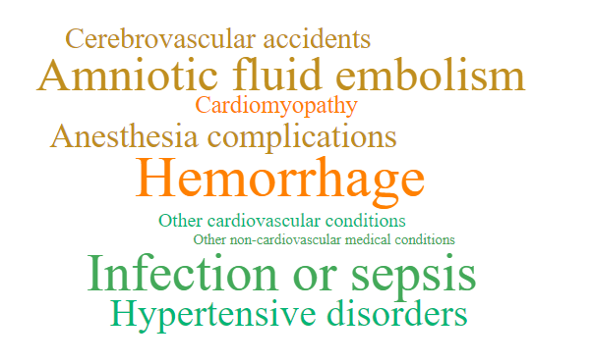
Causes of Maternal Mortality
4
According to the Center for Disease Control and Prevention
Notes:
So what are the causes of Maternal Mortality? The top causes are hemorrhage, infection or sepsis, embolisms, and hypertensive disorders. A large percentage of maternal deaths are preventable, making this a great indicator for overall community health.

Slide 18

The Environment & Social Determinants
Data from the Environmental Public Health Tracking Project.
6
Notes:
For the last section of this PowerPoint we will look at the environment and social determinants, data is from the HCSF & FDOH Miami-Dade’s Environmental Public Health Tracking Project.

Slide 19
Pre-term Births
Babies Who Are Preterm:
Risk Factors For Pre-term Birth
Increased risk for death
Short and long-term medical complications,
Neurodevelopmental sequelae
Race
Age
Socioeconomic status
Lifestyle (including tobacco use and substance abuse)
Low or high pre-pregnancy body mass index.
Notes:
Before we highlight some of the social determinants, we want to take a quick look at preterm births as this indicator will be used for the next few slides.
Preterm births are defined as infants born before the 37th week of gestation. Babies who are born preterm have an increased risk for a variety of health concerns including death, long-term complications, and even neurodevelopmental sequelae.
The top risk factors for pre-term birth leans heavily on the health of the mother. Which looks at her race, age, socioeconomic status, lifestyle, and even BMI.

Slide 20

Poverty Level
“There is a clear and established relationship between poverty, socioeconomic status, and health outcomes—including increased risk for disease and premature death”
-U.S Department of Health and Human Services
Negative health outcomes may worsen depending on:
Race
Ethnicity
Age
Notes:
The first determinant that we will look at is poverty level. For this, we will be looking at individuals who are living below the 100% marker level which equates to less than ~$12,490/year for a family of 1, or ~21,330 for a family of 3.
Why is poverty important? According to the U.S Department of Health and Human Services, there is a relationship between poverty and socioeconomic status and health outcomes.
Unfortunately, these health outcomes may be worse depending on your race or ethnicity, as we’ve seen in previous slides with infant and maternal mortality, and it may be worse with age. There are conditions, like dental cavities, that affect children in poverty more than adults in poverty.

Slide 21
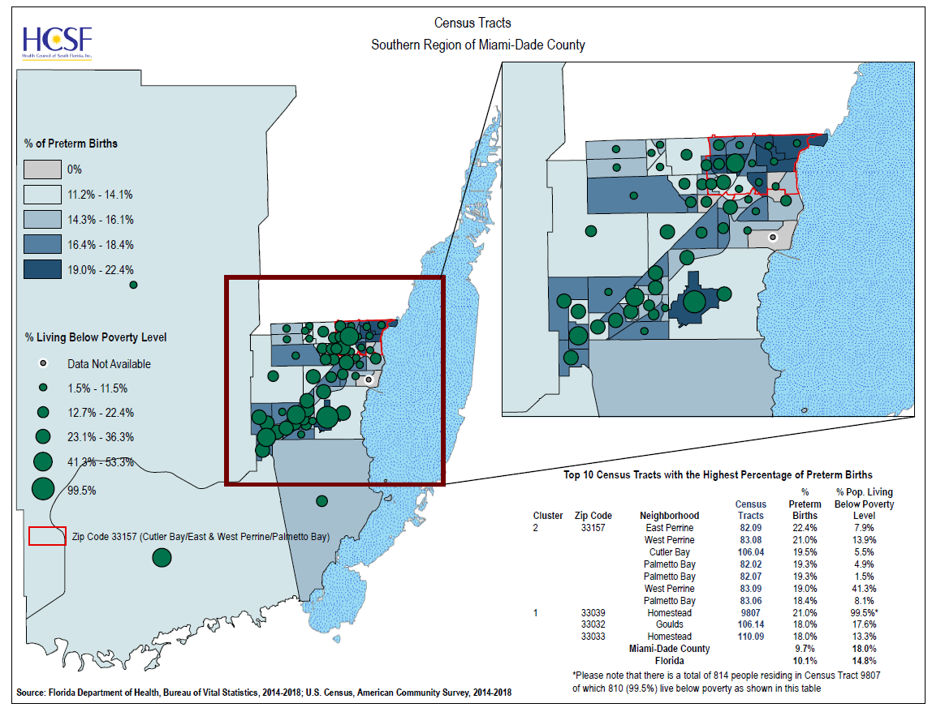
Map #1: Poverty Level
Percent of Preterm Births According to Percent of Population that live Below Poverty Level
Areas of Concern:
33157 (West Perrine/Cutler Bay
33039(Homestead)
33032(Princeton/Naranja)
33033(Homestead)
Notes:
The maps over the next few slides are from the Health Council of South Florida. On this slide, you’ll find a map related to poverty level. We wanted to determine if there is an association between preterm births and poverty level Miami-Dade. In this map we see that 33039(Homestead), 33032(Princeton/Naranja), and 33033(Homestead) have preterm births rates that are double that of Miami-Dade county and Florida. We also find in this region high percentages of the population living below the poverty line. Even more Interesting, we find that West Perrine & Cutler Bay has about 22% of their live births registered as pre-term, but only 7% of its population living below the poverty level, which is a rate lower than MDC and Florida.

Slide 22
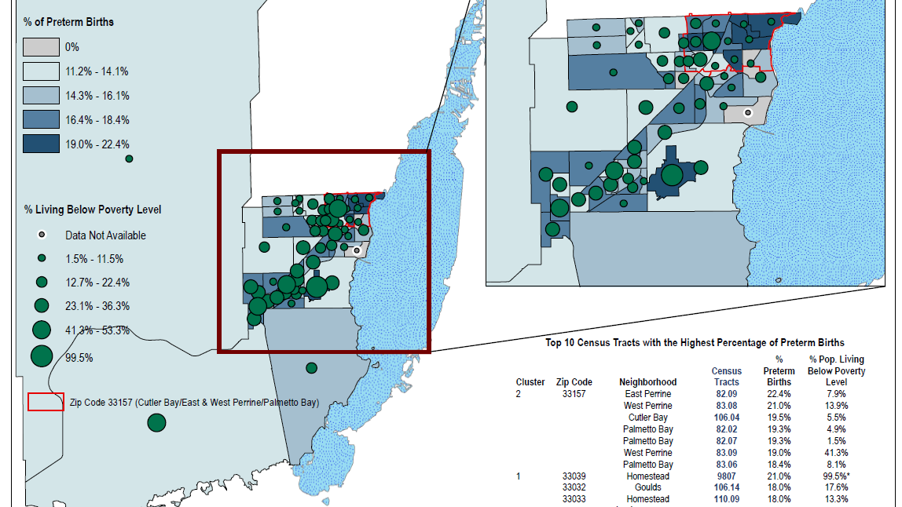
Notes:
Here is a close up image of the map that overlaps poverty level and preterm births.

Slide 23
Air Quality - Health Outcomes
“Air pollution in the form of particulate matter (PM₁₀) has been associated with an increase in the rate of postneonatal deaths. Postneonatal deaths occur from age 28 days through the first year of life. The major causes of death associated with PM₁₀ exposure are deaths from respiratory causes and Sudden Infant Death Syndrome, or SIDS. Pesticides have also been associated with fetal death and spontaneous fetal death or miscarriage, but more research is needed in this area.”
- Centers for Disease Control and Prevention, 2016
7
PM₁₀ – Large particles; Can also cause eye and throat irritation
Notes:
Next we will look at Air quality.
Remember when we highlighted causes of infant mortality a few slides back? This excerpt from the Centers for Disease Control and prevention highlights how air pollution, in this case, particulate matter of PM10, is associated with post-neonatal deaths– more specifically, Sudden Infant Death Syndrome. While this excerpt only highlights one condition, it shows how much of an impact air quality can have on one’s health. PM10, or Particulate Matter 10, of this size are large. This includes matter like dust. Which can cause eye, throat, and lung irritation and complications.
Q: What other conditions do you think can either be caused by or exacerbated due to poor air quality?
A:
- Asthma
-Heart Disease
- COPD
- Multiple forms of cancer
https://ephtracking.cdc.gov/showRbInfantMortalityEnv.action

Slide 24




Air Quality - Particulate Matter
Wood stoves
Forest fires
Powerplants
Factories
Motor vehicles
Emissions from industrial sites and motor vehicles contain PM_{2.5}
PM_{2.5} – Very small particles; These can enter your lungs and bloodstream
Notes:
Now that we’ve looked at PM10, let’s look at PM 2.5, which consists of very fine, small particles that are so small that they enter into very deep areas of your lungs and can also enter your bloodstream. Because of this, they can cause serious health outcomes especially among the most vulnerable and those who have been exposed over long periods of time. As you can see from the slide, powerplants, factories, and motor vehicles are well known for emitting these particles into the air.
https://www.cdc.gov/air/particulate_matter.html

Slide 25
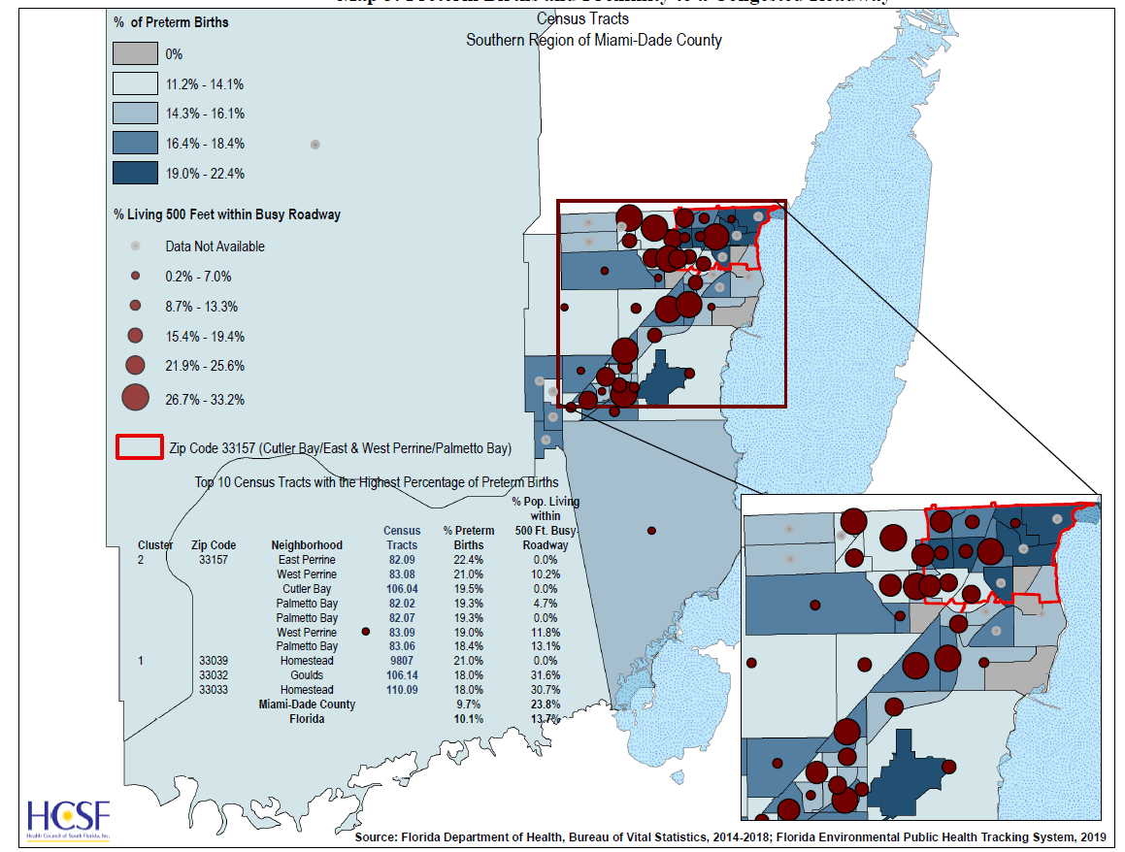
Map #2: Proximity To Roadway
Percent of Preterm Births According to Percent of the Population Residing within 500 Feet of a Congested Roadway
Areas of Concern:
33157 (West Perrine/Cutler Bay
33039(Homestead)
33032(Princeton/Naranja)
33033(Homestead)
Notes:
Now that we’ve looked at emissions and how vehicles contribute, let’s look at roadways with large amounts of traffic that are within the same vicinity of neighborhoods.
Q: Why would we want to look at this?
A: Overall air quality for communities
- Elongated exposure can be of huge concern meaning local populations may have higher rates of certain health conditions.
Research done by HCSF found that the zipcodes on the slide have preterm birth rates that are higher than the county AND the state. For instance the zipcode 33033 in Homestead had 18% of their live births registered as preterm. In this same zip code, 31% or close to one-third of the community lives within 500 ft of a congested roadway.

Slide 26
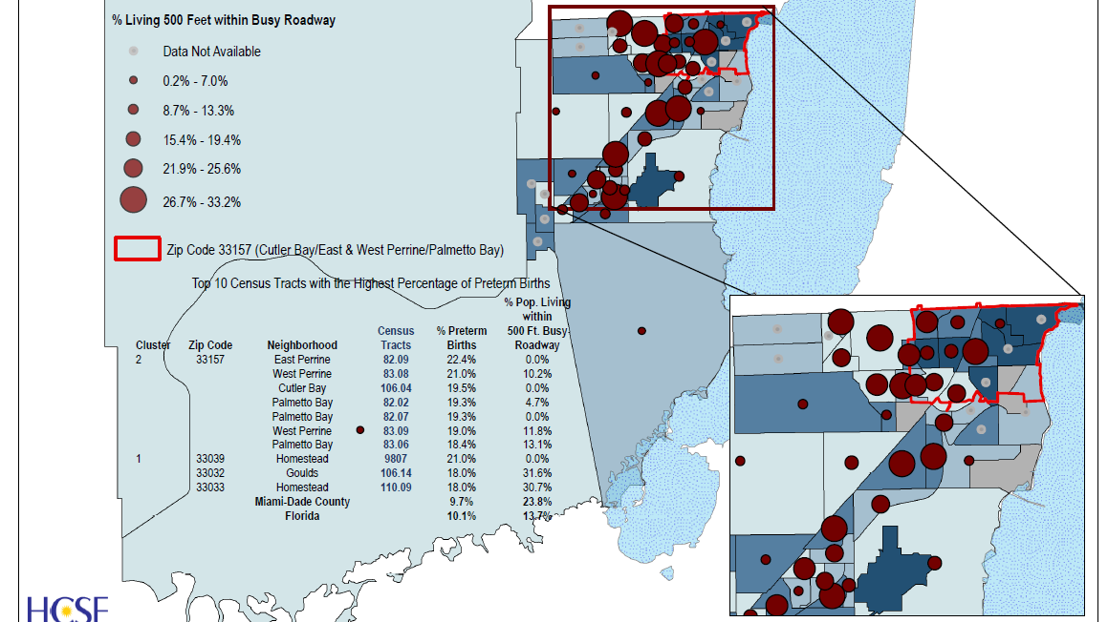
Notes:
Here is a larger image. As you can see, West Perrine / Cutler Bay, Homestead, and Princeton/Naranja are at the top of this list.

Slide 27



Health Insurance
“…if adults who now lack health insurance were to be insured on a stable and ongoing basis, their health status would likely be better than it would be without health insurance, and their risk of dying prematurely would be reduced.”
      - Institute of Medicine, 2002
As of 2018:
40.8 %
8
of Births in Miami-Dade are covered by Medicaid
of Births were self-Pay
(0.8% White, 2.1% Black) of births with known prenatal care status did not receive any prenatal care.
Births received Adequate Prenatal Care (Kotelchuck index)
10.2 %
9
1 %
10
79.5 %
11
All data is from FlHealthCharts.Com
Notes:
Lastly, we will look at health insurance which has been a hot topic in the U.S for several years due to its public health implications. This excerpt taken from the Institute of Medicine’s Committee on the Consequences of Un-insurance states “…if adults who now lack health insurance were to be insured on a stable and ongoing basis, their health status would likely be better than it would be without health insurance, and their risk of dying prematurely would be reduced.”
Q: Can anyone give a short summary of what they are trying to explain in this excerpt?
A: That the lack of insurance factors into one’s health.
Q: What role do you think insurance plays in health? What if someone doesn’t have insurance?
A: Lack of insurance means less doctor’s visits, less continuation of care, less likely to address acute and chronic symptoms.
As of 2018, 40.8% of births in Miami-Dade were covered by Medicaid and 10% of the births in the region were self-pay. 1% of all births with known prenatal care status didn’t receive any prenatal care. When broken down by race, we find that 0.8 % of White mothers didn’t receive any care compared to 2.1% of Black or African American Mothers.
Lastly, we see that 79% of births received adequate prenatal care. This is calculated by looking at the Kotelchuck index which looks at expected visits versus actual visits during a mother’s pregnancy. This is important as it gives professionals a snapshot of health care utilization in Miami-Dade.
*More in depth definition from FLHealthCharts:
Definition:
The Kotelchuck Index, also called the Adequacy of Prenatal Care Utilization (APNCU) Index, classifies the adequacy of initiation as follows: pregnancy months 1 and 2, months 3 and 4, months 5 and 6, and months 7 to 9. A ratio of observed to expected visits is calculated and grouped into four categories: Inadequate (received less than 50% of expected visits), Intermediate (received 50%-79% of expected visits), Adequate (received 80%-109% of expected visits), Adequate Plus (received 110% or more of expected visits). Mothers with unknown prenatal care are excluded from the denominator in calculating the percentage.
Why do we measure this?
This indicator is a measure of the adequacy of prenatal care provided to a woman by health care providers during the prenatal period. The adequacy of prenatal care utilization index provides a more comprehnsive measure of prenatal care utilization than the timing of prenatal care. High-risk pregnant women are likely to have high rates for adequate+plus care due to the many visits they receive.

Slide 28
Percentage Of Insured by Race & Ethnicity, Miami-Dade 2018
12
WHITE, ALONE
BLACK OR AFRICAN AMERICAN
ASIAN, ALONE
84.5 %
79.8 %
87.9 %
OTHER RACE
TWO OR MORE RACES
LATINO OR HISPANIC
77.6 %
89.1 %
82.6 %
Notes:
How does insurance coverage look when broken down by race and ethnicity? As you can see there is a slight variation between race and ethnicity in terms of insurance coverage.
https://data.census.gov/cedsci/table?q=miami%20dade%20county%20insurance&g=0500000US12086&tid=ACSST1Y2018.S2701&layer=VT_2018_050_00_PY_D1&vintage=2018&hidePreview=false

Slide 29
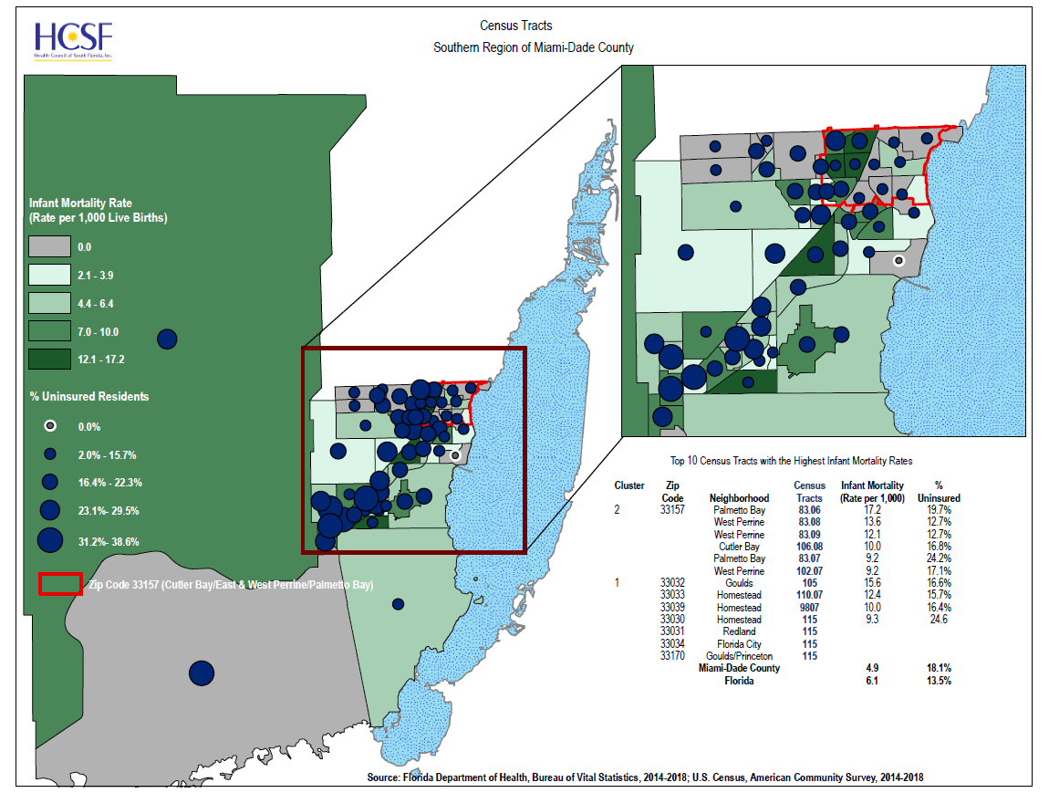
Map #3: Health Insurance
Infant Mortality Rate According to Percentage of Residents that are Uninsured
Areas of Concern:
33157 (West Perrine/Cutler Bay
33032(Princeton/Naranja)
33033(Homestead)
33039(Homestead)
33030 (Homestead)
33031 (Redland)
33034 (Florida City)
33170 (Goulds/Princeton)
Notes:
Instead of looking at pre-term birth, we are focusing on infant mortality in general and if health insurance is associated with its rates. Compared to the previous slides, there are more zipcodes or areas of concern. Miami-Dade County has an infant mortality of 4.9% and an uninsured rate of 18.1. All zipcodes listed exceed both of these rates. West Perrine / Cutler Bay bay has an infant mortality rate of 17.2%, almost 4 times more than MDC, and an uninsurance rate of 19.7.

Slide 30
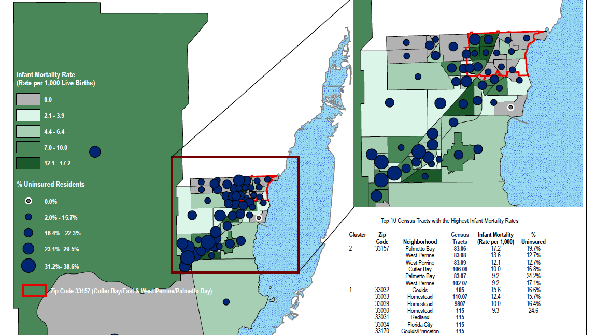
Notes:
Here is a zoom in photo of the map.

Slide 31
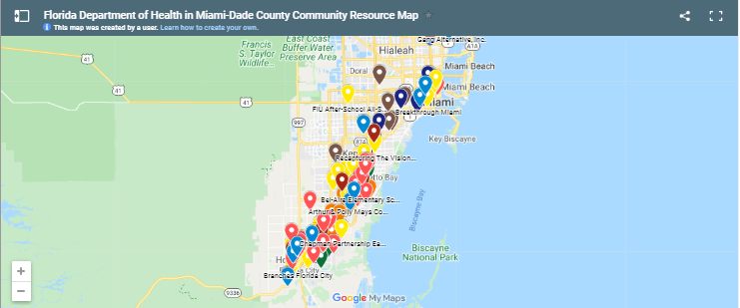
Resources For The Community
HealthyMiamiDade.Org
Visit the website to find resources and services near you
Notes:
Need information on local resources and services? The Consortium for a Healthier Miami Dade’s website has a map that’s easy to use with all of the following information:
Behavioral health resources
Community based services
Daycare
Disability resources
Domestic Violence Resources
Educational Programs
Faith Based Organizations
Health Programs
Parent and Family Support.

Slide 32
References
United States Census Bureau (n.d) https://www.census.gov/quickfacts/fact/table/miamidadecountyflorida/POP060210
Centers for Disease Control and Prevention. (2019). Infant Mortality. https://www.cdc.gov/reproductivehealth/maternalinfanthealth/infantmortality.htm
Florida Department of Health, Division of Public Health Statistics & Performance Management. (2020) Infant Deaths. http://www.flhealthcharts.com/charts/DataViewer/InfantDeathViewer/InfantDeathViewer.aspx?indNumber=0053
Centers for Disease Control and Prevention. (2020). Pregnancy Mortality Surveillance System. https://www.cdc.gov/reproductivehealth/maternal-mortality/pregnancy-mortality-surveillance-system.htm
Florida Department of Health, Division of Public Health Statistics & Performance Management. (2020). Maternal Deaths. http://www.flhealthcharts.com/charts/DataViewer/InfantDeathViewer/InfantDeathViewer.aspx?indNumber=0392

Slide 33
References
Health Council of South Florida, Inc. & Florida Department of Health in Miami-Dade County (2020). Environmental public health tracking project.
Centers for Disease Control and Prevention. (2016). National environmental public health tracking: reproductive and birth outcomes. https://ephtracking.cdc.gov/showRbInfantMortalityEnv.action
Florida Department of Health, Division of Public Health Statistics & Performance Management. (2020). Births covered by Medicaid. http://www.flhealthcharts.com/charts/DataViewer/BirthViewer/BirthViewer.aspx?cid=0595
Florida Department of Health, Division of Public Health Statistics & Performance Management. (2020). Births with self-pay for delivery payment source. http://www.flhealthcharts.com/charts/LoadPage.aspx?l=~/DataViewer/BirthViewer/BirthViewer.aspx?cid=0617
Florida Department of Health, Division of Public Health Statistics & Performance Management. (2020). Births to mothers with no prenatal care. http://www.flhealthcharts.com/charts/DataViewer/BirthViewer/BirthViewer.aspx?cid=0016

Slide 34
References
Florida Department of Health, Division of Public Health Statistics & Performance Management. (2020). Births with Adequate Prenatal Care (Kotelchuck index). http://www.flhealthcharts.com/charts/DataViewer/BirthViewer/BirthViewer.aspx?cid=0615
United States Census Bureau. (n.d). Selected characteristics of health insurance coverage in the united states https://data.census.gov/cedsci/table?q=miami%20dade%20county%20insurance&g=0500000US12086&tid=ACSST1Y2018.S2701&layer=VT_2018_050_00_PY_D1&vintage=2018&hidePreview=false

Slide 35
Thank You

